Slide 1
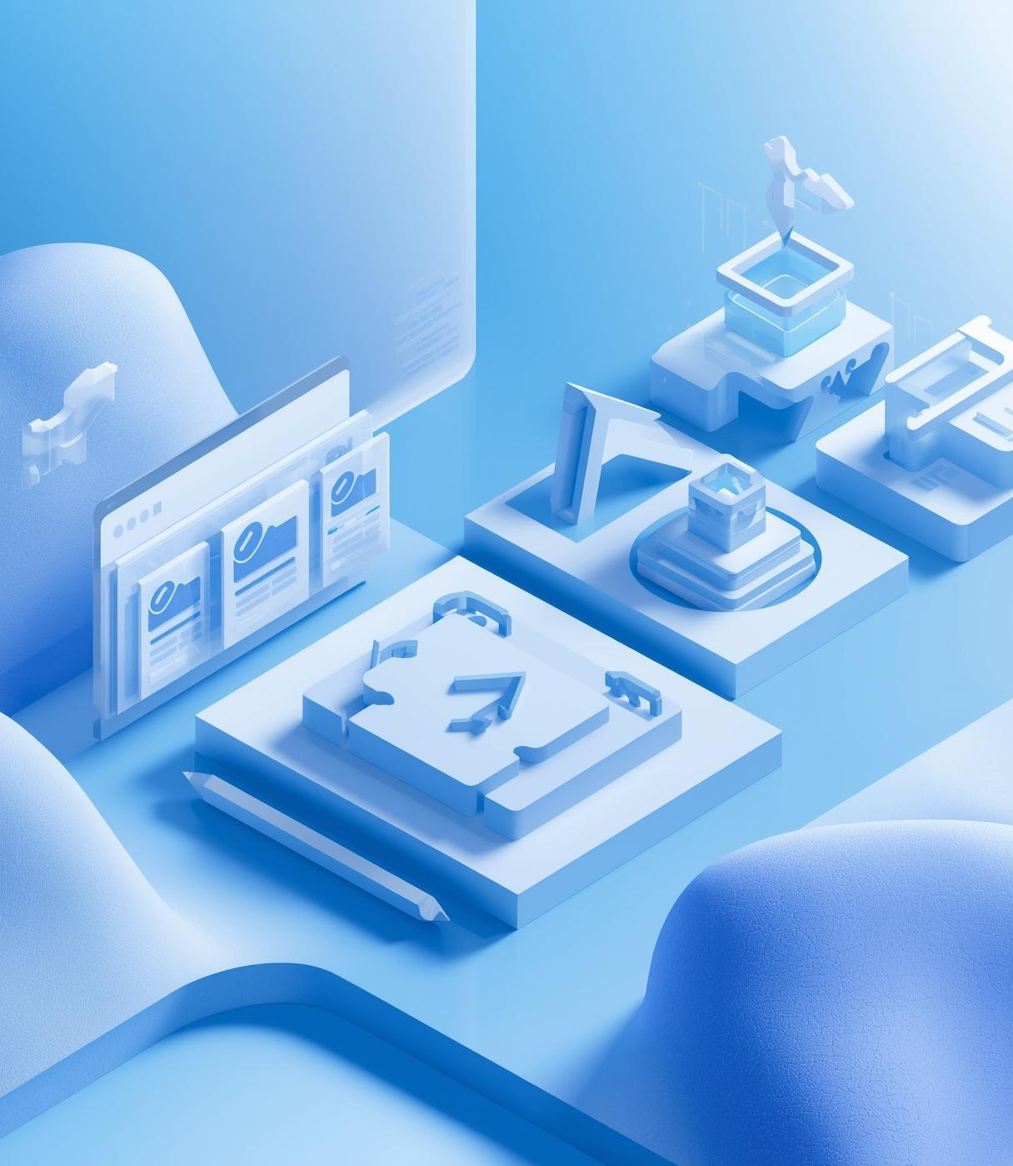

Tech Innovations
Advanced Browser Navigation System Using Stacks
Data Structures – Mini Project
PRESENTED BY
• B. Thanishka—AP24110011830
• M. Harika — AP24110011839
• G. Sourabi — AP24110011844
• D. Bindhu — AP24110011845

Slide 2
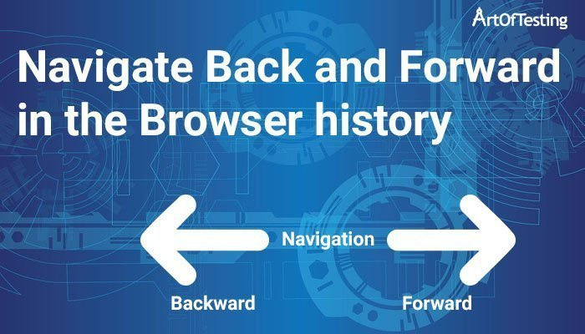
Introduction to Navigation
Efficient navigation systems are essential for enhancing user experience. They streamline user interactions with web browsers, ensuring smooth transitions and access to previously visited pages.

Slide 3
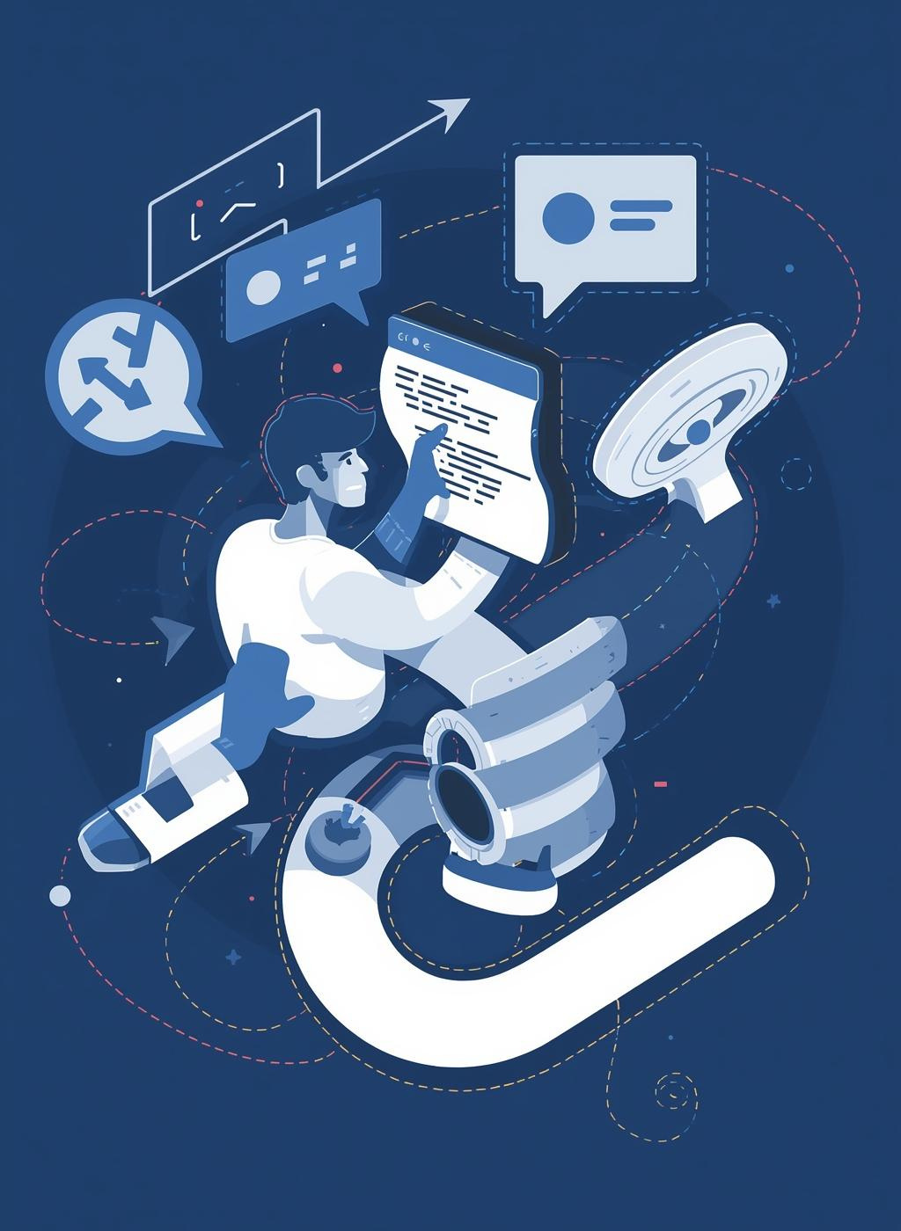
Navigation Model Challenges
Traditional browser navigation systems struggle with limited history handling and often lead to poor user control, resulting in frustration when trying to trace navigation paths effectively.

Slide 4
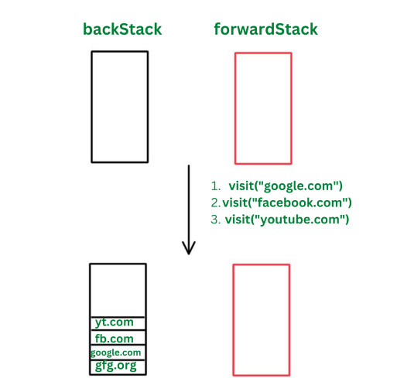
Objectives
The aim of this project is to design an advanced navigation system using stacks, improving user control and enhancing browser navigation through effective back and forward functionalities.

Slide 5
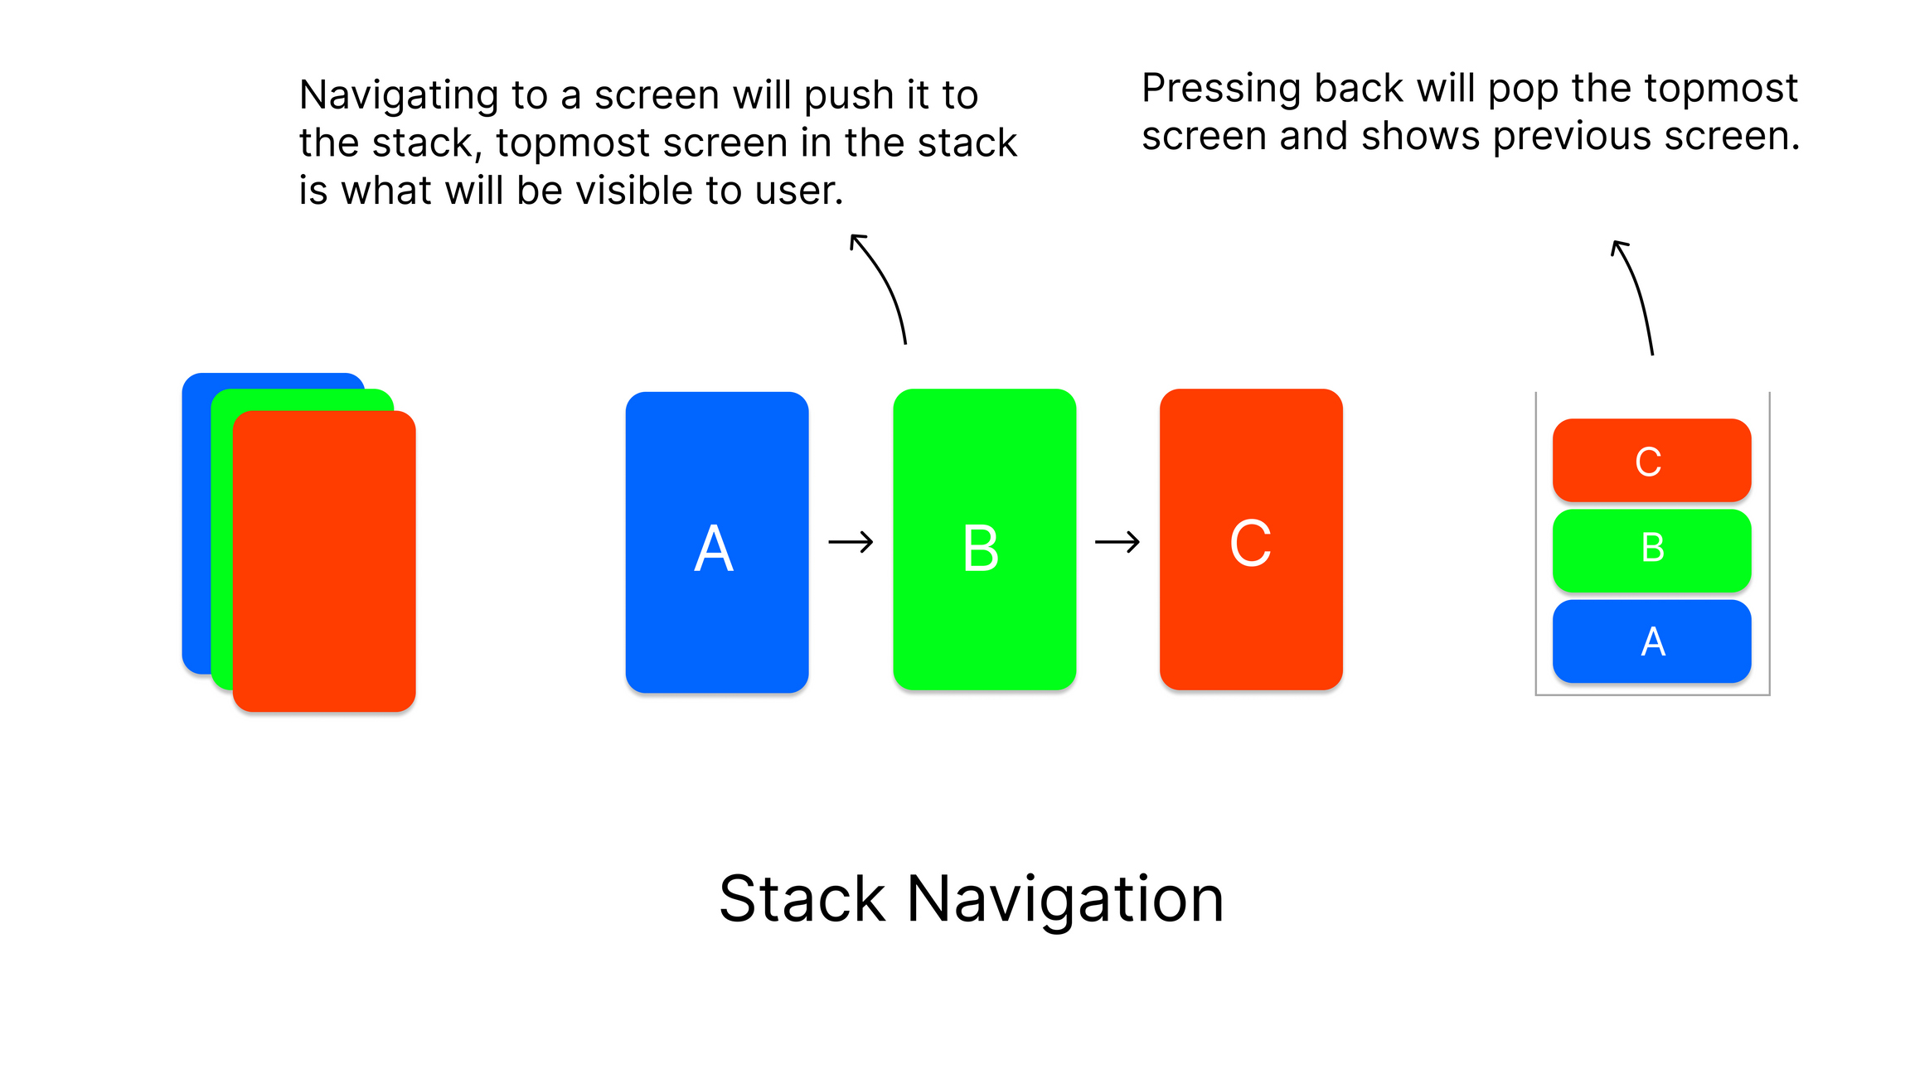
Stacks in Navigation
Stacks are crucial in browser navigation due to their Last In, First Out (LIFO) nature, which aligns perfectly with how users move back and forth through their browsing history.

Slide 6
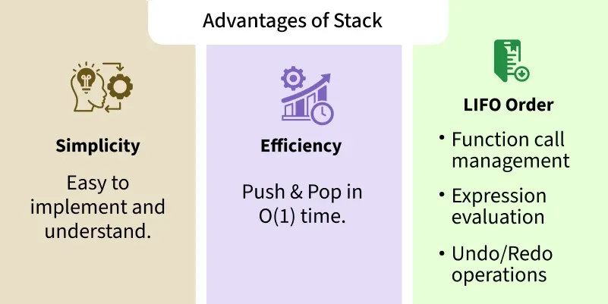
Benefits of Stacks
The stack-based navigation system significantly enhances user experience by providing efficient navigation and robust tracking of history, which leads to improved accuracy and reliability in browsing.

Slide 7
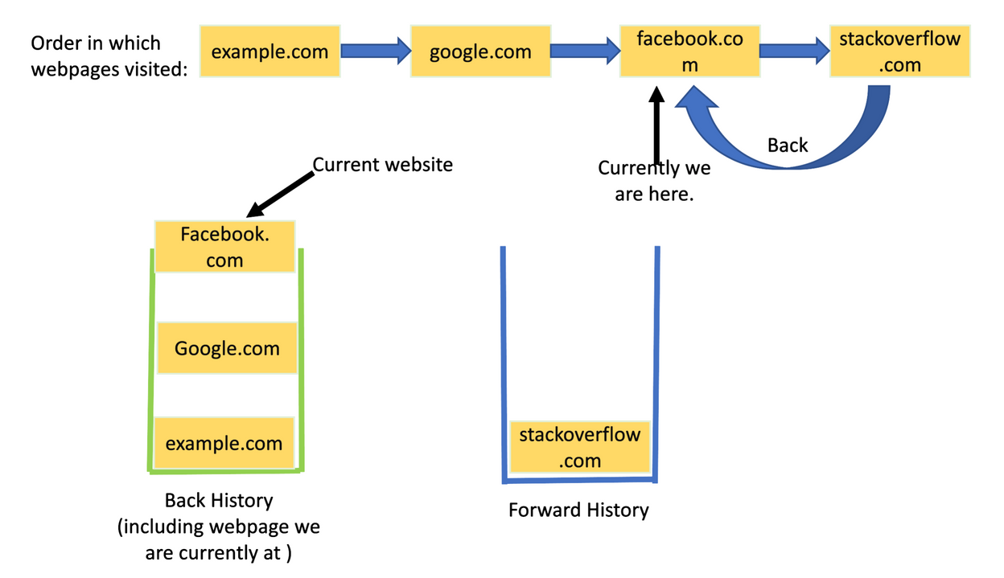
Methodology Overview
• Two stacks are used: Back Stack and Forward Stack.
• Visiting a new website → Push current page to Back stack + Clear Forward stack
.
• Back navigation → Push current page to Forward stack + Pop from Back stack.
• Forward navigation → Push current page to Back stack + Pop from Forward stack.
• Additional modules: Bookmark storage, search, reopen closed page, and file export.

Slide 8
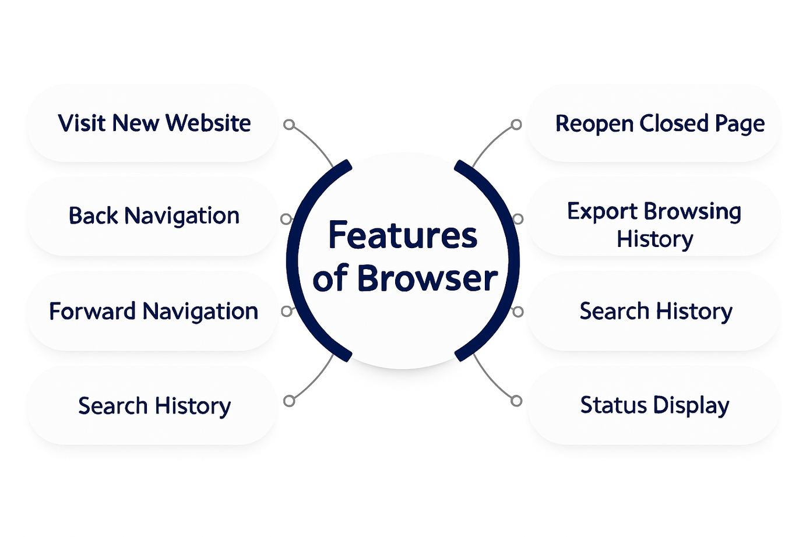
Features Implemented:

Slide 9
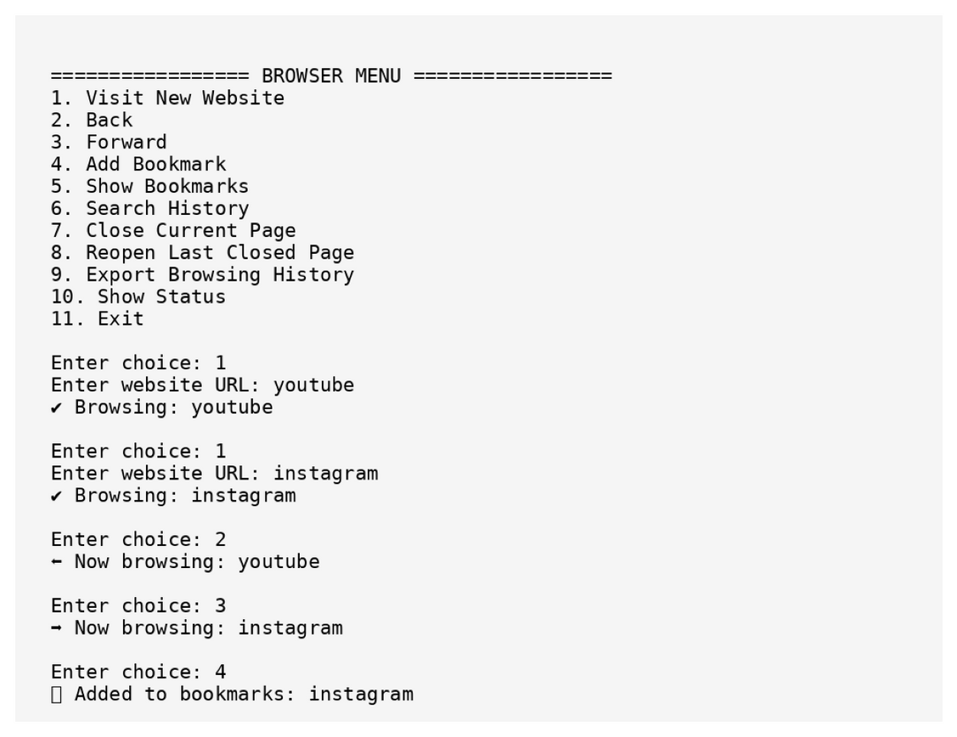
Output Screenshots
NAVIGATION BUTTONS
The user interface features intuitive navigation buttons that allow users to move back and forth through their browsing history seamlessly, enhancing overall user experience and accessibility.
STACK STATE VISUALIZATION
A dynamic visualization of the stack state provides users with real-time feedback on their navigation history, illustrating how pages are pushed and popped to maintain accurate and efficient browsing paths.

Slide 10
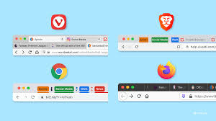
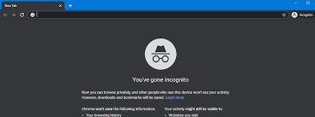
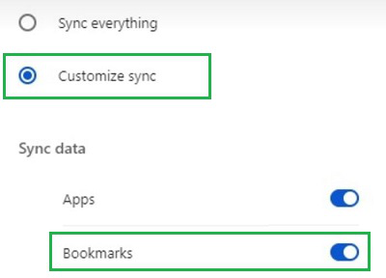
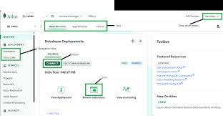
Future Enhancements
This section explores how integrating tabbed browsing can enhance user experience, allowing users to navigate seamlessly across multiple pages without losing track of their history.
• Introduce private/incognito browsing mode.
• Add support for multiple tab browsing.
• Enable synchronization of bookmarks .
• Include graphical user interface (GUI).

Slide 11
Thank You

